Slide 1
{MEETING NAME}
{DESCRIPTION OF MEETING}

Slide 2
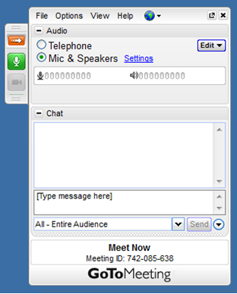
Welcome to the {MEETING NAME}
You may do a sound check
when you first log in, then
please mute yourself by
clicking on the green mic
button:
If you’re having trouble
connecting to the audio, send a
message to the provincial team
through the chat window.

Slide 3
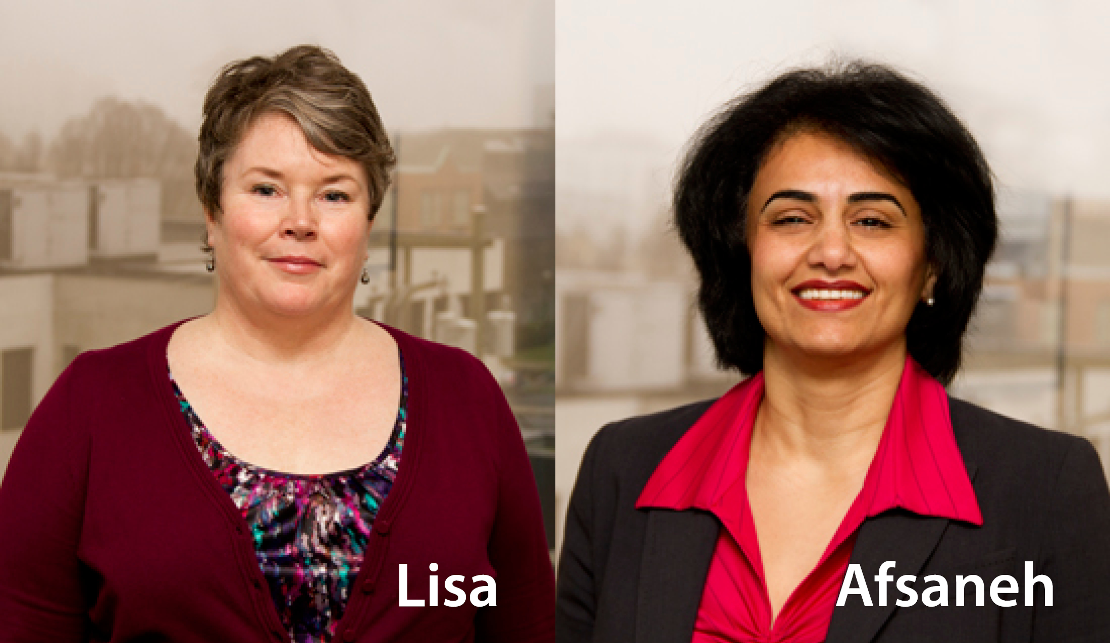
Presenters
Lisa Adams
Physician Engagement Leader
Afsaneh Moradi
Physician Engagement Leader

Slide 4
Thank you

