Slide 1
PracticeinBC.ca

Slide 2
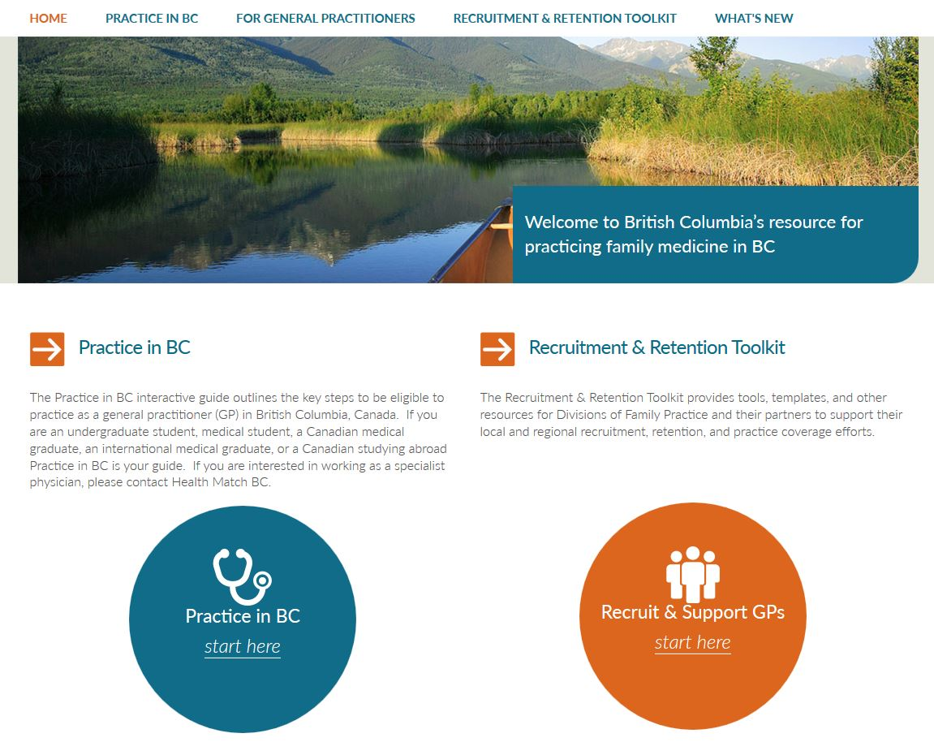
Discover PracticeinBC.ca
Notes:
PracticeinBC.ca is a one-stop web portal created to help make it easier for new family doctors to join BC communities.
The website was created by the Divisions of Family Practice Recruitment and Retention Steering Committee, which is funded by the GPSC.
The portal has two parts:
(Indicate the blue circle) A one-stop source of information for GPs interested in practicing in BC, and
(Indicate the orange circle) tools and information to help divisions and local family doctors recruit and support new GPs.

Slide 3
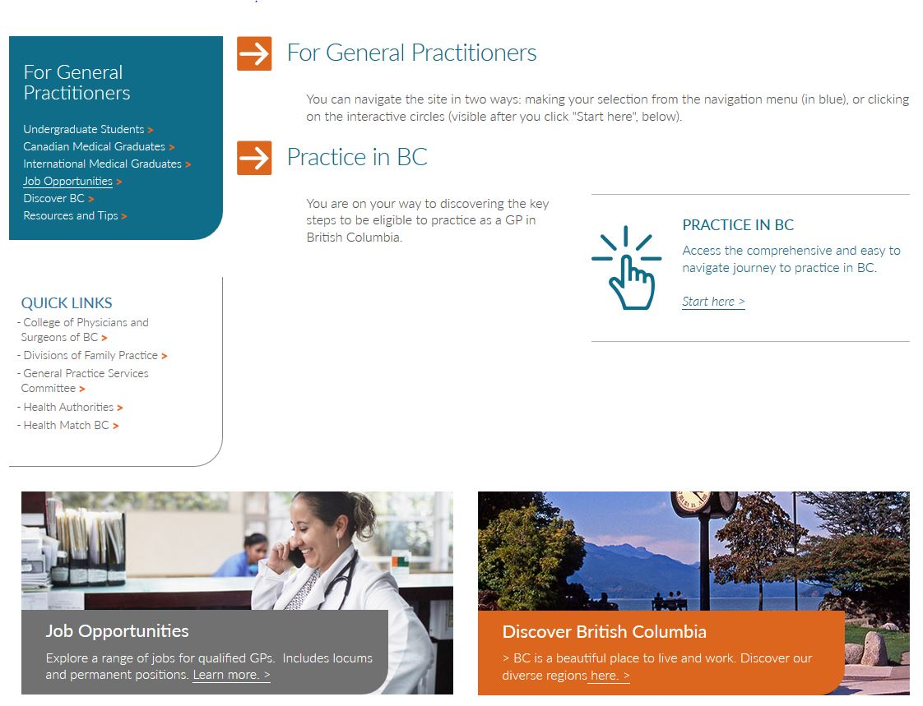
PracticeinBC.ca: one-stop portal for GPs
Notes:
In one place, PracticeinBC.ca brings together everything family doctors, residents, and students need to know about moving to and practicing in BC communities like ours.
No matter where they are located or what stage they’re at in their careers, our future colleagues will be supported by PracticeinBC.ca through information on:
Applying to medical school.
Immigration processes.
Licensing processes.
Lifestyle options across BC.
How to find a BC job practicing family medicine.

Slide 4

Valuable Recruitment and Retention Tools
Notes:
The second part of PracticeinBC.ca is the recruitment and retention toolkit.
It has a variety of easy-to-access information to support both Division-driven and individual recruitment efforts including:
Preparing for successful family doctor recruitment and retention.
Attracting new family doctors.
Engaging family doctors in community life.
Supporting new family doctors in obtaining the appropriate licensing and privileges.
PracticeinBC.ca is the first and only site of its kind, bringing together information from a variety of sources into a single access point.
It has never been easier for people interested in being a BC family doctor - or recruiting one - to find the information they need.
I encourage you to spend some time on PracticeinBC.ca yourself and learn everything the site has to offer.

